Slide 1
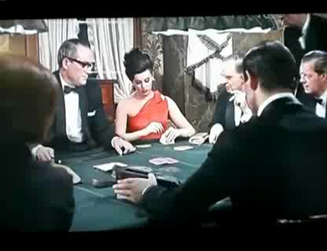
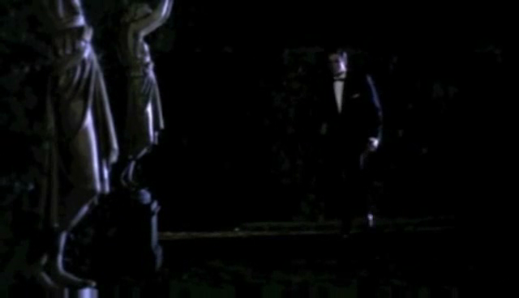


In the second movie, From Russia With Love, the red herring appears: the pre title scenes
Thanks to the director Terence Young, Dr No sees the first instance of the words, Bond, James Bond
After being a best selling fictional character, James Bond first appears in the movie, Dr No, in 1962.
This starts with the famous gunbarrel scene
0
0
7
Goldfinger Brings It All Together: Character, Action, Story and Music
The story of how the film adaptions of the books of Ian Fleming become incredible successes
Celebrating 50 Years Of the James Bond Movies

